Slide 1
Islamic finance – a regulatory perspective
Arshadur Rahman
Manager, Shari’ah Compliant Facilities Project

Slide 2
Presentation structure
Definitions, origins and key principles
The market and recent developments
Regulatory and policy implications
The Bank of England’s Shari’ah compliant facilities (SCF) project

Slide 3
1. Definitions, origins and key principles

Slide 4
What is Islamic finance?
Shari’ah refers to the high level principles of Islamic law
Islamic finance is a broad term covering products and services deemed consistent with Islamic commercial jurisprudence (“fiqh”)
Commonly framed in terms of prohibitions against what are considered to be socially detrimental activities/industries (e.g. alcohol, gambling, tobacco, etc), and especially charging interest
But also entails a greater emphasis on risk/reward sharing, transparency, sustainability, and social justice
Overlap with the broader ethical/sustainable finance movement

Slide 5
Origins
The well known prohibition on interest can be found in various traditions through history – e.g. Hinduism, Buddhism, ancient Greece, Judaism, Christianity and Islam
Early Islamic finance was based on nominate commercial contracts used by the Muslim community from AD/CE c.620 onwards
In the modern context, Islamic finance motivated at least partly by desire for parallel/separate institutions and economic paradigms, by newly independent majority Muslim countries
Mit Ghamr Savings Project in Egypt (1963)
Islamic Development Bank (IDB) and Dubai Islamic Bank both established in 1975

Slide 6
Key principles
Wealth creation must relate to broader social benefit
Prohibitions on:
Interest (“riba”) – money is a medium of exchange, has no intrinsic value
Excessive uncertainty (“gharar”) – e.g. in contract terms, object of sale
Hoarding – capital should not sit idle. E.g. compulsory alms payments (“zakat”) are calculated on total wealth, not income
Misrepresentation or lying
Emphasis on:
Risk and reward sharing – partnership arrangements are preferable, rent-seeking should be avoided
Transparency
Fairness – forced sales/sales under duress are forbidden

Slide 7
2. The market and recent developments

Slide 8
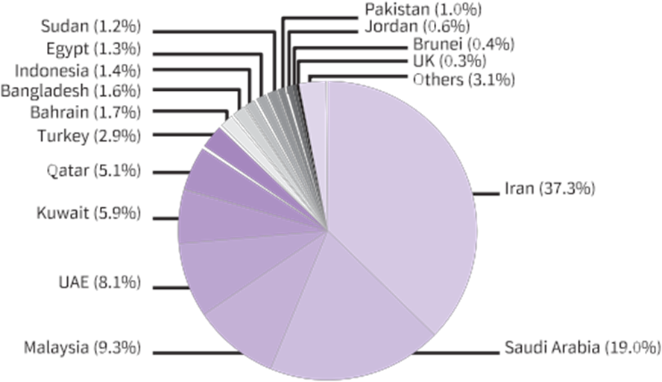
Islamic finance globally – growth of the market
Islamic banking assets growth over time and share by country
Source: IFSB 2016 Stability Report
Global Islamic finance assets currently estimated to be worth c.$2trn
Mostly constituted by banking (c.$1.6trn) and capital markets (c.$0.4trn)
Takaful sector much smaller: c.$22bn globally as of end 2014
The market is still young

Slide 9
Islamic finance globally – key bodies
The Islamic Development Bank (IDB)
Multilateral Development Bank based in Jeddah
Has already issued USD denominated sukuk (of which more later…)
The Islamic Financial Services Board (IFSB)
Issues standards on governance and risk management
Collaborates with various bodies: BIS, IMF, IOSCO, IAIS
The Accounting and Auditing Organisation for Islamic Financial Institutions (AAOIFI)
Issues standards on accounting and Shari’ah compliance
Rules are binding in only a few jurisdictions (e.g. Bahrain, Sudan)
The IMF(?)

Slide 10
Islamic finance in the UK – recent history
Various forms of Islamic finance activity since the 1970’s
Shari’ah compliant aviation leasing contracts from the 1970s
Wholesale liquidity management from the 1980s
Earliest forms of Islamic mortgages from the 1990s
2003 - Governor George confirmed no objection in principle to Islamic banking in the UK
First standalone Islamic bank authorised in 2004, five more subsequently up to 2009 (though one is now an investment firm)
Banking sector also includes 20+ windows
2014 - UK government issued its first sovereign sukuk
2015, the Bank commences Shari’ah compliant facilities (SCF) project
Also: commercial sukuk; asset management; insurance; advisory

Slide 11
Islamic finance in the UK – financial products
Shari’ah compliant bank accounts – structured in several ways:
Current accounts can be structured as an interest free loan (“qard”) to the bank, repayable on demand
Fixed term accounts can be structured as agency agreements (“wakalah”), the bank invests the funds in Shari’ah compliant activity
Home financing
Structured as a sale/resale at mark-up (“murabaha”) of property by bank to customer, who pays down resale value through monthly increments
A partnership arrangement (“musharaka”) - joint purchase by customer (initial deposit) and bank (outstanding value), with customer increasing ownership share via monthly instalments

Slide 12
Islamic finance in the UK – financial products (cont.)
Investment management
Involves applying industry/financial screens to securities selection
Shari’ah compliant insurance (“takaful”)
Normally uses mutual-type structures to pool risk
Limited activity in the UK currently, but growing
Securitisation (“sukuk”)
Commonly taken to represent a legal/beneficial interest in an asset or enterprise
Economic/risk profile can vary depending on contractual details
Most common structure for fixed income instruments is lease-based (“ijarah”)

Slide 13
Islamic finance in the UK – the market currently
Currently five standalone Islamic banks in the UK
One retail (al Rayan Bank)
Four largely wholesale (BLME, Gatehouse, QIB and ADIB)
Combined balance sheet is c.£3.2bn
Plus windows…
Combined value of sukuk issuances outstanding on the LSE: c.$38bn
Insurance – one underwriting agency; Lloyds becoming more active
Various fund managers

Slide 14
Islamic finance in the UK – Government policy
Islamic finance first featured notably on the UK Government’s objectives in 2007, and has cross-party support
Tax treatment has been harmonised through successive pieces of legislation to ensure consistency with conventional instruments
The current administration is promoting the UK as a centre for Islamic finance as part of its aim to increase inward investment/regeneration
HMT/DMO’s sovereign 2014 sukuk was very successful, oversubscribed 11.5 times – a signalling device to encourage more corporate issuances
Cross-Whitehall Islamic finance working group co-ordinates initiatives across govt – jointly led by HMT and FCO

Slide 15
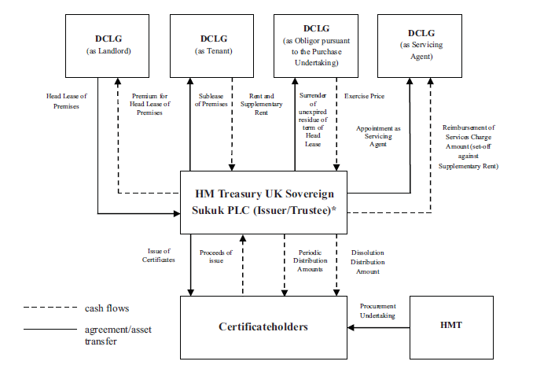
Islamic finance in the UK – the sovereign sukuk
£200m 5yr lease based sukuk secured on 3 central government buildings

Slide 16
3. Regulatory and policy implications

Slide 17
The UK regulatory approach
Our 2007 regulatory paper* outlined the key elements of our approach:
No obstacles, but no special favours
Level playing field
We are a secular, not religious regulator
No separate rule book for Shari’ah compliant firms
Consequently, we expect development of Islamic finance in the UK to be largely market led – the authorities provide the framework for this to happen
* http://www.fsa.gov.uk/pubs/other/islamic_finance.pdf

Slide 18
How does Shari’ah relate to the UK legal framework?
Shari’ah consists of high level principles, not rigid rules
Therefore, interpretations of Shari’ah can, and do, differ
The UK applies a legal framework based on secular common law
This means statutory authorities in the UK cannot opine on whether a product/activity is Shari’ah compliant or not
Precedent: Beximco vs. Shamil Bank (2004)
It is up to the parties to a contract to satisfy themselves that the product is compliant with Shari’ah principles, depending on their particular interpretation
Adequate product disclosure is essential – and relevant transparency requirements apply to all firms.

Slide 19
What is the regulatory position of Shari’ah scholars?
Shari’ah scholars are considered to act in an advisory capacity to Islamic banks
Similar to a firm’s external auditors or legal counsel
They are therefore not generally required to be Approved Persons for regulated firms (i.e. authorised to engage in regulated activity)
Caveat: if Shari’ah scholars perform an executive/customer facing function for a regulated firm, then they do need to be Approved Persons

Slide 20
Risk profile and characteristics of Shari’ah compliant firms in the UK
From a regulatory perspective, we do not consider these firms to be more or less risky than conventional firms
Risk profiles will vary as a function of business model, and effective corporate governance is key
Islamic banks for example may face the following challenges
Increased concentration risk, due to dealing with a narrower range of counterparties/clients/products
Difficulties achieving economies of scale, if they are starting from a small base
Increasing brand recognition, if they are relatively new
But these risks are not unique to Islamic banks

Slide 21
Islamic banks – depositor protection
Banks in the UK accepting deposits from retail customers must be members of a depositor protection scheme
To qualify as a deposit, there must be capital certainty - we focus on the economic and risk profile of a product to decide this
However, capital certainty may render a deposit product non-compliant with Shari’ah principles
In the UK, depositor protection on Shari’ah compliant bank accounts must be clearly communicated to customers
It is up to them whether they wish to take advantage of it
They only need to decide this after any potential loss event
It is important to clearly define – and communicate to customers – whether/on what basis Islamic bank deposits are protected

Slide 22
General considerations with Islamic finance
Don’t be overwhelmed by jargon! Focus on the economic and risk characteristics of the transaction/product/service
Islamic financial products are not identical to conventional products – care should be taken when assuming equivalence between e.g. bonds and sukuk
Islamic finance is primarily a commercial enterprise, distinct from charitable activity
As secular authorities, we do not opine on Shari’ah compliance, but we can be mindful of market opinion

Slide 23
4. The Bank of England’s Shari’ah compliant facilities (SCF) project

Slide 24
Islamic banks - liquidity
All banks in the UK must hold a buffer of liquid assets to comply with liquidity requirements
Islamic banks find it challenging to source eligible assets which are both of sufficient quality and also Shari’ah compliant.
Total LAB requirement of 5 UK Islamic banks = c.£200m
Total estimated sukuk stock globally = c.$390bn equiv.
Of which, total HQLA estimate = c.$56bn equiv.
But, most HQLA sukuk held to maturity, limited secondary market
Rules offer some flexibility on eligible assets, subject to haircutting – but not sufficient to address underlying scarcity
Hence the Bank’s project on Shari’ah compliant facilities

Slide 25
The Shari’ah compliant facilities (SCF) project
The Bank of England recognises the challenge of UK Islamic banks in meeting the liquidity requirements, given the current scarcity of eligible assets for the LAB
We are therefore assessing the feasibility of establishing a Shari’ah compliant central bank liquidity facility – work on this formally commenced in H2 2015
The first stage was to survey and assess existing facilities in use by central banks around the world
The Bank conducted a consultation green paper in 2016, receiving feedback from a range of stakeholders: Islamic banks, conventional finance firms, overseas central banks and regulators, scholars, academics

Slide 26
The Bank of England’s SCF assessment criteria
We evaluated a number of SCF models against a set of agreed criteria:
Transparency/simplicity
Fitness for purpose
Acceptable degree of risk
Compatibility with the Sterling Monetary Framework
Accessible specifically to the target population
Consistency/fairness of pricing
Proportionality of resource requirements
Market readiness

Slide 27
SCF liquidity facilities around the world
Deposit facilities:
Wakalah (agency based fund model)
Commodity murabaha (cost plus mark up)
Wadiah (safe custody)
Mudarabah (entrepreneurship)
Ju’alah (task specific remuneration)
Liquidity support facilities:
Collateralised commodity murabaha
Wa’ad (promise) a.k.a. sale and buy-back/Shari’ah compliant repo
Qard (interest-free loan)
Other models:
Open Market Operations (OMOs)
Interbank ‘clearing’ model

Slide 28
Shari’ah compliant facilities
Deposit model 1: the fund based model

Slide 29
Shari’ah compliant facilities
Deposit model 2: the commodity murabaha model

Slide 30
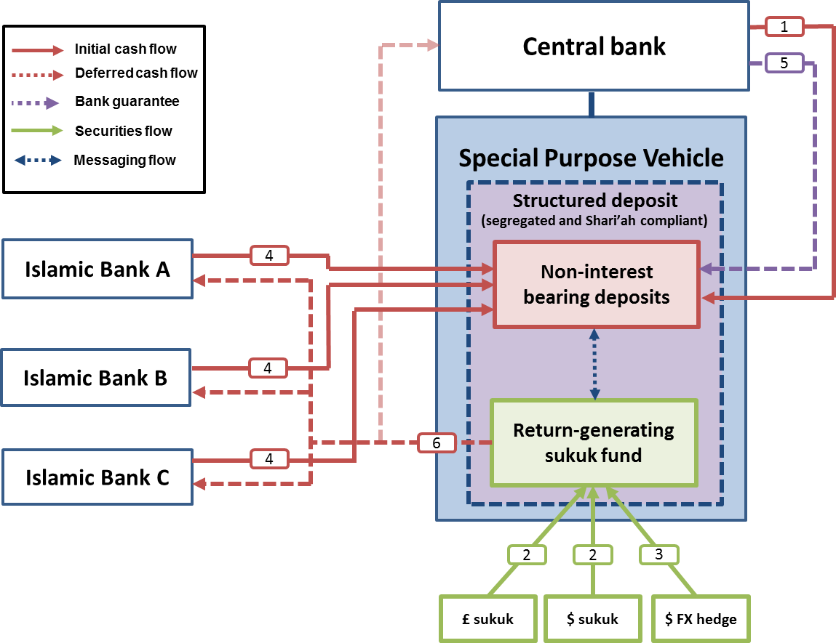
The proposed fund based model (detail)

Slide 31
Next steps
The Bank’s 2017 white paper provides more technical detail of the proposed Shari’ah compliant deposit facility
Notwithstanding any material obstacles, implementation will follow (estimated to commence later in 2017)
After a few years of operation, the facility will be evaluated against its objectives
Subject to successful operation, the next stage will be to implement a Shari’ah compliant liquidity support facility

Slide 32
Any questions?

