Slide 1
Building Resilient Capital Markets: Some thoughts from Islamic Finance.
Obiyathulla Ismath Bacha
INCEIF
BRUNEI DARUSSALAM ISLAMIC CAPITAL MARKET CONFERENCE 2018 (BICAM 2018)

Slide 2
Setting the stage - Key Questions?
Forty years of IBF – what lessons can we learn?
How effective has been the replication strategy?
The global footprint of IBF, where are the gaps?, the missing links?
What are the opportunities for a new market?
Is growth possible through filling the gaps?

Slide 3
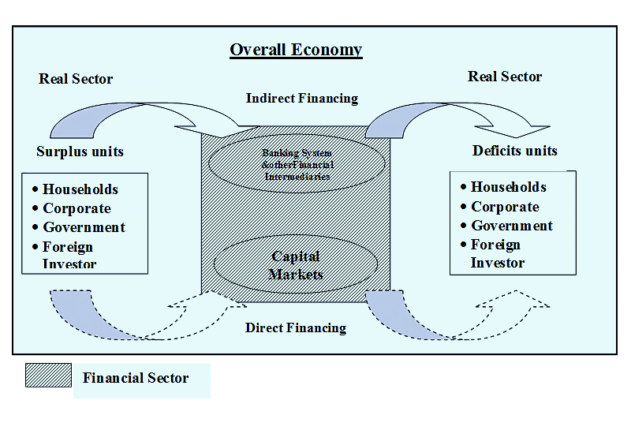
Capital Markets and The Financial And Real Sectors

Slide 4
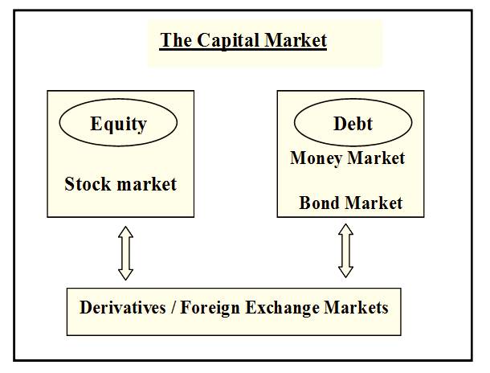
The Key Components Of A Typical Capital Market

Slide 5
What do Capital Markets do?
Traditionally; four functions
Intermediation, between surplus and deficit units.
Providing the payments system
Enabling inter-temporal transfers, and
Medium for monetary policy transmission

Slide 6


What do Capital Markets do?
Enabling inter-temporal transfers
Intermediation, between surplus and deficit units.
Medium for monetary policy transmission
Providing the payments system

Slide 7
What do Capital Markets do?
Modern capital markets have an expanded role.
Means and avenue for risk management – derivative markets
Price discovery – interest rates, cost of funds (cost of debt, equity)
Assimilate the actions of participants and reflect them as market information.
The ability of capital markets to disseminate information in a timely manner and in a cost effective way is perhaps the most important function of markets these days.

Slide 8
Identifying the key gaps/missing links.
i) Global presence but missing link in intermediation.
ii) Infantile Capital Markets, Banking sector dominance.
iii) Reliance on debt based contracts/instruments.
iv) Disconnect with funding of development needs.
v) Lack of market trading; The need for price discovery.

Slide 9

Gap 1
Global presence but missing link in intermediation.

Slide 10
i) Global presence but missing link in intermediation.
IBF now has a global presence.
IFI’s operate across many countries including non Muslim ones.
Several non Muslim jurisdictions have issued sovereign sukuk.
Despite the global footprint, there appears to be a missing link when it comes to intermediating between Muslim world resources and its needs.

Slide 11
Rank | Sovereign Wealth Fund | Assets in USD billions
1 | Norway- Norway Global Pension Fund | 922.11
2 | UAE-Abu Dhabi- Abu Dhabi Investment Authority | 828
3 | China- China Investment Corporation | 813.8
4 | Kuwait- Kuwait Investment Authority | 524
5 | Saudi Arabia- SAMA Foreign Holdings | 514
6 | China Honk Kong- Hong Kong Monterary Investment Portfolio | 456.6
7 | China- China SAFE Investment Corporation | 441
8 | Singapore- Government of Singapore Investment Corporation | 359
9 | Qatar- Qatar Investment Authority | 320
10 | China- National Security Fund | 295
11 | UAE-Dubai- Investment Corporation of Dubai | 209.5
12 | Singapore- Temasek Holdings | 197
13 | Saudi Arabia- Public Investment Fund | 183
14 | UAE-Abu Dhabi- Mubadala Investment Company | 125
15 | UAE-Abu Dhabi- Abu Dhabi Investment Council | 110
16 | South Korea- Korea Investment Corporation | 108
17 | Australia- Australia Future Fund | 99.4
18 | Iran- National Development Fund of Iran | 91
19 | Russia- National Welfare Fund | 72.2
20 | Libya- Libyan Investment Authority | 66
Source: Sovereign Fund Institute 2017

Slide 12
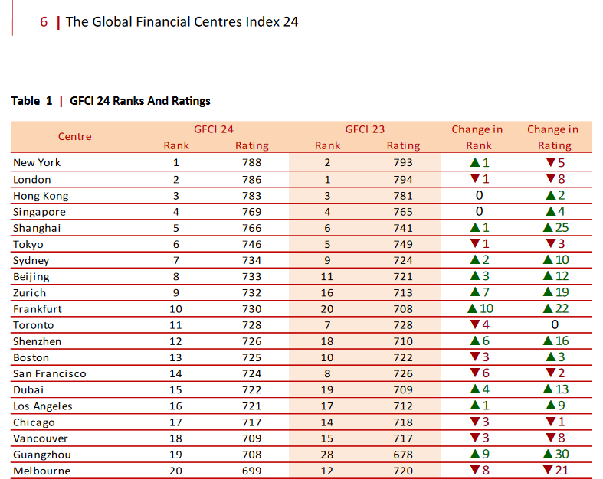
Source: https://www.longfinance.net/media/documents/GFCI_24_final_Report_7kGxEKS.pdf report dated Sept 2018

Slide 13
10 of the top twenty SWFs are from the Islamic world.
Total assets of these ten SWF’s approximates 3 trillion US $.
By comparison, the total volume of ṣukūk issued in 2016 was US$ 75 billion, total outstanding ṣukūk close to USD 320 billion. (IFSB – 2017)
Islamic Fund Assets for 2016 totalled US $ 56 billion.
Global total Islamic Banking assets approx. US$ 1.5 trillion. (IFSB – 2017)
Considering the leverage model of banking, shifting a small portion of SWF assets, can support Islamic banking size several times larger.

Slide 14
The missing link?
With equity typically less than 10% of banking assets, or US$ 150 billion in 2016, its obvious that not much SWF money has gone into funding Islamic Banking assets.
Similarly given the sizes of Islamic Funds and Sukuk, it seems unlikely that SWF funds had gone into these.
How about Equity markets? Could SWF assets gone into equity markets of the Muslim world?

Slide 15
Average market cap for top ten = US$ 208 billion

Slide 16
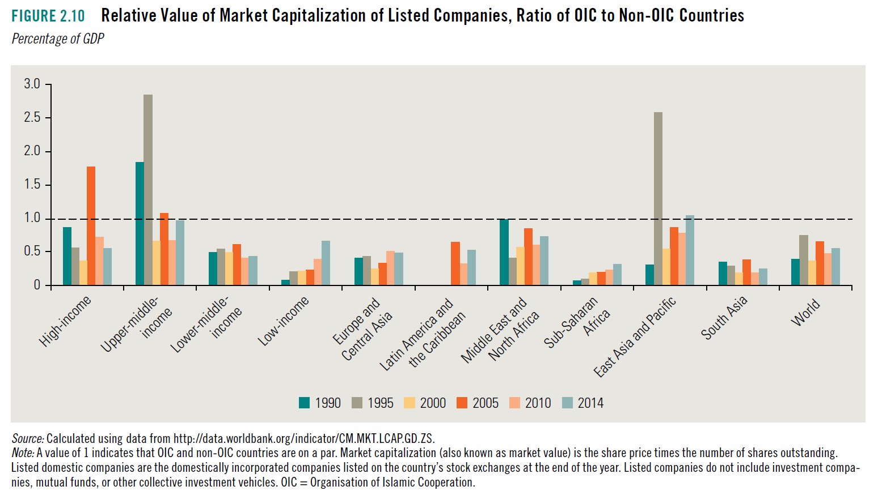

Slide 17
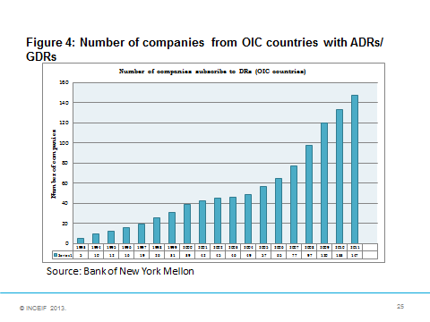

Slide 18
The missing link?
Based on the Market Cap and ratio comparisons, it seems obvious that not much SWF resources of the Muslim world has gone into its equity markets, sukuk or into Islamic Banking assets.
Clearly there appears there appears to be little if any intermediation of Muslim wealth back into Muslim countries / societies.
SWF assets are being invested in the financial centres of the West.
Whatever intermediation if any is happening through western banks/ money centres.

Slide 19
Gap 2
Infantile Capital Markets, Banking sector dominance.

Slide 20
ii) - Infantile Capital Markets, Banking sector dominance.
According to IFSB, the situation as of end 2016 is as follows;
IBF total = US$ 1.9 trillion of assets
Sukuk = 17%
Islamic Funds = 3%
Takaful = 1 %
Islamic Banking = 79 %
Clearly, the global IBF sector is heavily skewed.

Slide 21
Relative Sizes – Islamic Banking vs Sukuk and Equity Funds, Takaful
Source: Islamic Financial Services Industry Stability Report 2017

Slide 23
Nasser Saidi (2013). Asia: Coming Financial Transformation. -Seoul, 27th May 2013.

Slide 24
ii) - Infantile Capital Markets, Banking sector dominance.
What’s wrong about this skewed reliance on banking?
A bank-dominant financial sector is invariably more riskier than one that is capital market- centric.
Two reasons;
First, intermediation is indirect for banking, but direct for capital markets.
Incentives, motivations differ. Maturity transformation inherent mismatch.
Second, the banking model results in risk concentration where a single imprudent bank can bring down the entire system.

Slide 25
What’s wrong about this skewed reliance on banking?
With risks transferred on to banks and concentrated within the system, governments have little choice but provide banks with a range of implicit and explicit guarantees.
Capital markets do not require this !!
Two key disadvantages to society
Increased Macro economic vulnerability
2) The cost to society from these contingent liabilities is massive.

Slide 26
The Irony !!
The irony is that the Muslim world is filled crown jewels remain buried without their intrinsic values being harnessed for the greater good of society.
Case in Point - ARAMCO
Saudi Aramco alone, even at its lower end valuation of US$2 trillion, would be about three to four times the market capitalization of Apple or Alphabet the world’s largest companies.!
Listing to have been in New York, London, HK etc. Why??

Slide 27
Gap 3
Reliance on debt based contracts /
instruments.

Slide 28
iii) Reliance on debt based contracts/instruments.
Islamic banking is suppose to be universal banking, yet, replication has meant the reliance on debt based contracts.
Islamic Banks today have equal if not higher duration gaps than conventional banks.
One sees the same dominance of debt within the sukuk space.

Slide 29
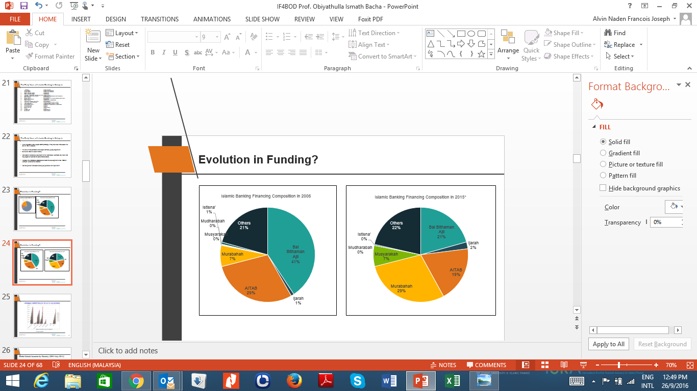
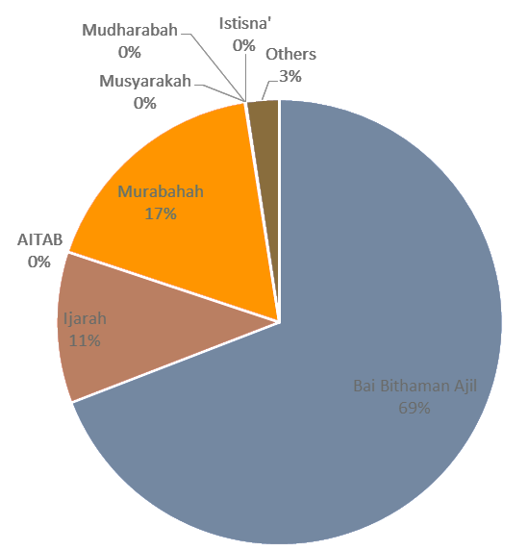
Reliance on debt based contracts/instruments
Islamic Banking Financing Composition in 1990*

Slide 30
Global Sukuk Issuance by Contract (2001-July 2014)
The dominance of debt contracts – Global Sukuk
Source: IIFM Sukuk Database

Slide 31
The convergence between Sukuk and Bond yields.
Correlation of Sukuk and Bond Yields – Turkey (maturing 2018)
Correlation of Sukuk and Bond Yields – Malaysia (maturing 2016)
Source: Abdullah Karatas (2018), PhD Manuscript, INCEIF.
Correlation of Sukuk and Bond Yields – Indonesia (maturing 2018)

Slide 32
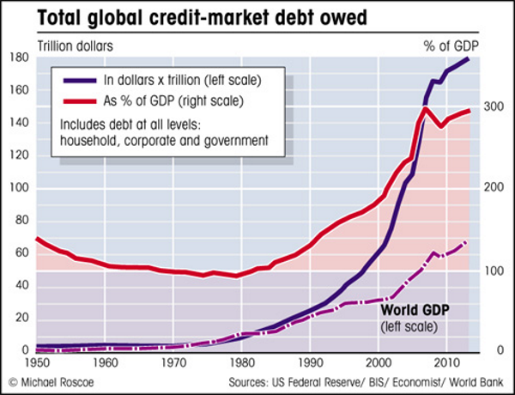

Slide 33
Gap 4
Disconnect with funding of development needs.

Slide 34
iv)Disconnect with funding of development needs.
“ Economic growth is the most powerful tool we have to end poverty, yet without infrastructure- electricity, water and roads – growth will never take off.” – W.B. President Jim Yong Kim at launch Global Infrastructure Facility (GIF)
The majority of emerging market and developing economies (EMDE) in Asia and Africa are Muslim countries.
The 57 countries of OIC, with a combined population 1.6 billion people, fall within the EMDE category.
-51 of the 57 countries have budget deficits
- 19 of them are classified as HIPC (heavily indebted poor country).
According to a World Bank report, the OIC countries,
- have years of pent-up deficits in infrastructure, inhibiting their ability to exploit their full development potential.
have very rapidly rising populations and very high youth unemployment.
have pressing need for socio-economic infrastructure
Mobilizing Islamic Finance for Infrastructure, PPP – Report 2017. World Bank, PPIAF, IDB

Slide 35
iv)Disconnect with funding of development needs.
Brookings Institution; over 2016−2030, needed global investment in infrastructure is around $90 trillion.
The need for development financing within the Islamic world is obvious.
Muslim nations like Turkey and Indonesia have massive infrastructure plans but lack the funding resource.
Many of the needed projects are low risk, potentially high return projects.
The low hanging fruits – of development economics.
But given very high levels of debt (debt to GDP ratios), these countries are in no position to fund development infrastructure with foreign debt.

Slide 36
Source: Mobilizing Islamic Finance for Infrastructure, PPP – Report 2017. World Bank, PPIAF, IDB 2017

Slide 37
The disconnect between debt and infrastructure projects.
Infrastructure projects typically, have high operating leverage.
FC to TC is very high. VC/MC of production is negligible.
Debt financing adds an additional layer of fixed costs thereby
increasing break even points,
increasing cash flow volatility,
exposing the project to interest rate risk
cumulatively increasing overall risk.
By finance theory; High Operating Lev. + High Financial Lev. = disaster
Compounded effect that produces magnified revenue/cash flow volatility.
The correct financing alternative for such projects would be one that does not add to already high fixed costs but is fully flexible with project performance.

Slide 38
Not only are sukuk mostly debt based, the majority of outstanding sukuk are short term.
Source: Thomson Reuters Eikon

Slide 39
Congruence between Islamic Finance and Infrastructure Projects
Principles of Islamic Finance
Infrastructure Project features
Returns linked to earnings and derived from commercial risk taken by financier.
Infrastructure projects allow for risk to be shared among parties.
Financiers should become partners in project
Projects can be designed for financier to be partners and not just lenders.
Transactions should be free from speculation or gambling (maysir)
Infrastructure projects are by nature free from speculation or gambling
Existence of uncertainty/looseness of contract is prohibited
Projects are generally well defined with no uncertainty (such as lump sum, turn-key, EPC contracts).
Investments in alcohol, drugs, gambling, weapons and other prohibited activities are not permitted.
Development infrastructure typically exclude these areas.
Source: Mobilizing Islamic Finance for Infrastructure, PPP – Report 2017. World Bank, PPIAF, IDB 2017

Slide 40
The Risk Sharing Contracts of Islamic Finance
Islamic finance provides alternatives of a risk-sharing nature.
Mudarabah and Musharakah are essentially quasi equity contracts.
Evidence of use by Italian city states to fund trade and development as Commenda.
Later resurfaced as “venture capital” financing in Silicon Valley.
In both cases, the risk sharing philosophy of Mudarabah was used but the contract was “tweaked” to introduce controls.

Slide 41
Modified Mudarabah Sukuk
  This structure is relevant for public, private or public-private partnerships financing models
Key Benefits
Reduces dependence on debt and avoids leverage
Minimises dilution (asset specific and terminal
Provides inbuilt stabiliser to the funding entity
Avoids rates risk and contagion
Features
Sukuk Securitisation
Equity Kickers
No first loss provision
Structure of payments, flexibility
Cost – Allowable, Enumeration
Required returns based on project risk

Slide 42
Funding type and resulting project risk profile
New Project [Risk]
Project risk is shared
Lower risk as project risk is shared with new shareholders
Project risk is transfered to equity holders
Higher risk as (1) the same group of existing shareholders have to take on new project risk
+
(2) financing risk (leverage)
Project risk is shared
Lower risk as shared with sukuk holders. Maximum risk limited to % of investment
Mudarabah results in no increase in financial leverage, reduces vulnerability to external shocks and comes with an inbuilt stabilizer.
The risk-sharing, terminality and limited dilution are important advantages that the Mudarabah has relative to debt.
The seeming advantage that debt has over equity in the debt-equity tradeoff is substantially altered when Mudarabah financing comes into the picture.
New equity
debt
Mudarabah sukuk

Slide 43
A new asset class for development financing.
Sukuk designed on MM can enable funding of development without debt.
Returns anchored in real sector ; not only be more stable but higher relative to the rates of debt instruments.
Infrastructure projects are long lived, have stable and steady cash flows. The instruments would mimic low beta stocks.
Given the nature of their cash flows, their returns would have little correlation with conventional portfolios.
The low correlation implies strong diversification possibility when combined with conventional portfolios.
Most importantly, there is no interest rate sensitivity.

Slide 44
Gap 5
Market trading; The need for price discovery.

Slide 45
v)Market trading; The need for price discovery.
A recent IMF study of IBs and CBs found
IBs had much more liquidity (liquid assets) on their balance sheets relative to conventional banks.
IBs are less profitable by ROE and ROA.
the lower ROA and ROE of Islamic banks is the direct result of carrying too much liquidity.
Why too much liquidity? - unproductive assets. Both bank shareholders and depositors lose.
CBs have gotten around this by way of Interbank Money Markets.

Slide 46
Market trading; The need for price discovery.
With the exception of Malaysia, which has an IIMM, most other countries with IBs have bilateral arrangements.
Solves liquidity problem but no price discovery.
But how does the Central bank determine the right cost/yield?
How do banks price financing to customers? - conventional rates?
It is no surprise therefore that after more than 30 years of Islamic banking, there is no Islamic benchmark rate.
Thus, today we have several large global sovereign sukuk outstanding that have their returns benchmarked on LIBOR (London Interbank Offer Rate).

Slide 47
Market trading; The need for price discovery.
In the absence of market trading, a Shariah compliant benchmark cannot be derived.
Three key problems with this:
i) IBF will always have to depend on interest rates for its activities.
ii) IBF will always be less profitable and more costly.
iii) Cost of capital to Shariah compliance will be higher – disadvantaged.
Clearly, there are long term costs from absent markets/trading.

Slide 48
Concluding remarks.
For an aspiring new market like Brunei, the way forward should be obvious.
Position to fill the existing gaps.
Such a strategy not only faces less resistance but is safer - lower risk.
This would allow for a truly meaningful impact on the Islamic world.

Slide 49
Conclusion - Specific Strategies
Position domestic Capital market as the link for cross border intermediation within the Islamic World.
- Create/offer Islamic Depository Receipts (IDRs)
- Enable Cross listing of Stocks
- Be the Luxembourg for the Islamic Finance.
2) Don’t Replicate, Innovate. In particular Risk Sharing instruments.
- New asset class
No rate sensitivity
No contagion
Massive diversification potential

Slide 50
Conclusion - Specific Strategies
3) Emphasise real sector investments – infrastructure financing through risk sharing sukuk that is listed and traded here.
- Brunei benefits as intermediary
- developing nations benefit from non debt source for devt financing
4) Provide/be the platform for the listing and trading of Shariah compliant short/medium term papers. Ijarah, Mudarabah, Musyarakah etc.
Build the enabling microstructure, systems, market makers, electronic clearing etc.
This would enhance price discovery.
Potential to be the reference market for global pricing of Islamic papers.

Slide 51
Thank you
obiya@inceif.org
INCEIF, The Global University of Islamic Finance
Lorong Universiti A,
59100 Kuala Lumpur, Malaysia

